Slide 1
Inventory Management System
By
Hemanth Punna
Mayur Chavan
Mayank Sharma
Afnaan Ahmed
Krishna Zanwar

Slide 2
Table of contents
Abstract
Introduction
Technologies
Screenshots

Slide 3
Abstract
Inventory management system that is beneficial to business owners and allows sellers and venders to keep track of their purchases and sales. Customers will be frustrated if inventory is mismanaged, and there will be too much cash locked up in sluggish sales and warehouses. This inventory eliminates paper work, human errors, and manual delays, allowing the process to move more quickly. This inventory management system will be able to keep track of sales and available inventory, as well as alert shopkeepers when it's time to reorder and how much to buy. Inventory management system is a Windows application that focuses on inventory control and generation for Windows operating systems.

Slide 4
INTRODUCTION
Inventory management aids businesses in determining what stock to order and when to order it. It keeps track of inventories from start to finish, from purchase to sale. The practise monitors and responds to trends to ensure that there is always adequate stock to satisfy client orders and that any shortages are detected early enough.Inventory is revenue after it is sold. Inventory, despite being a balance sheet asset, holds up cash before it sells. As a result, having too much inventory costs money and cuts into cash flow.Inventory turnover is a metric that can be used to determine how well a company manages its inventory. Inventory turnover is a financial metric that shows how frequently stock is sold over time. Stock should not exceed sales in a business. Deadstock, or unsold stock, is a result of low inventory turnover.

Slide 5
Technologies Used
CSS
JavaScript
PHP
DataBase
MySQL
Cloud service used – AWS (Amazon Web Services)

Slide 6
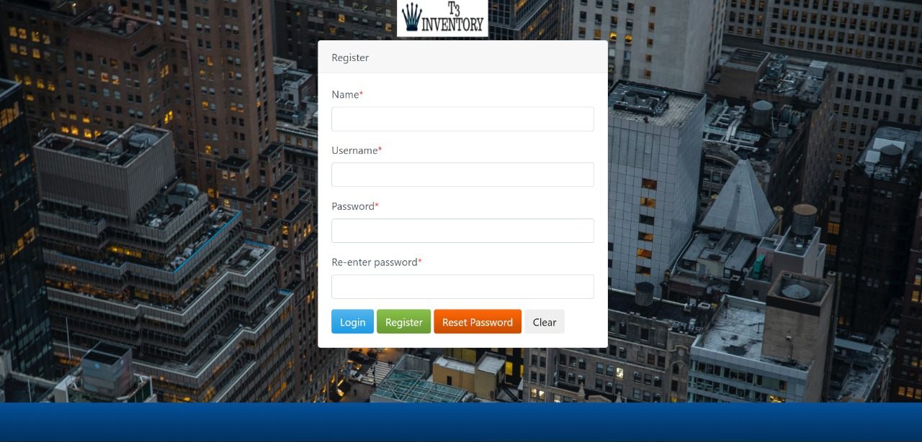
Screenshots

Slide 7
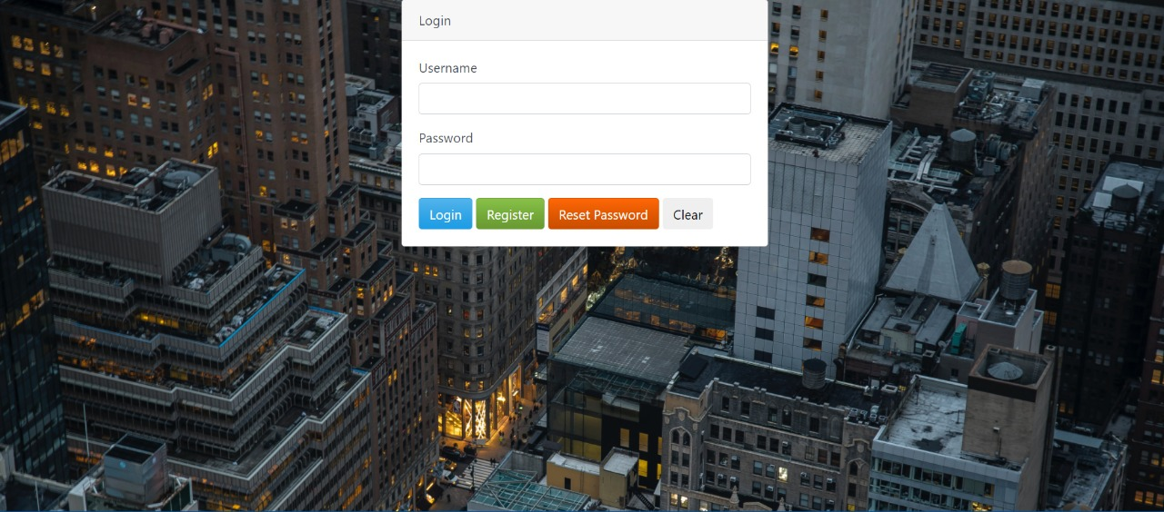
Screenshots

Slide 8
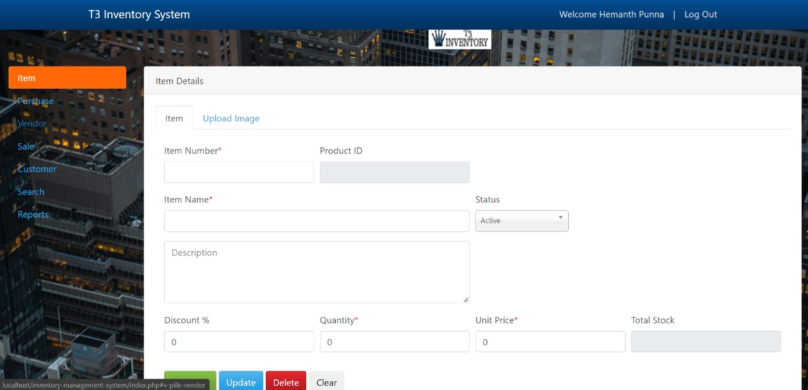
Screenshots

Slide 9
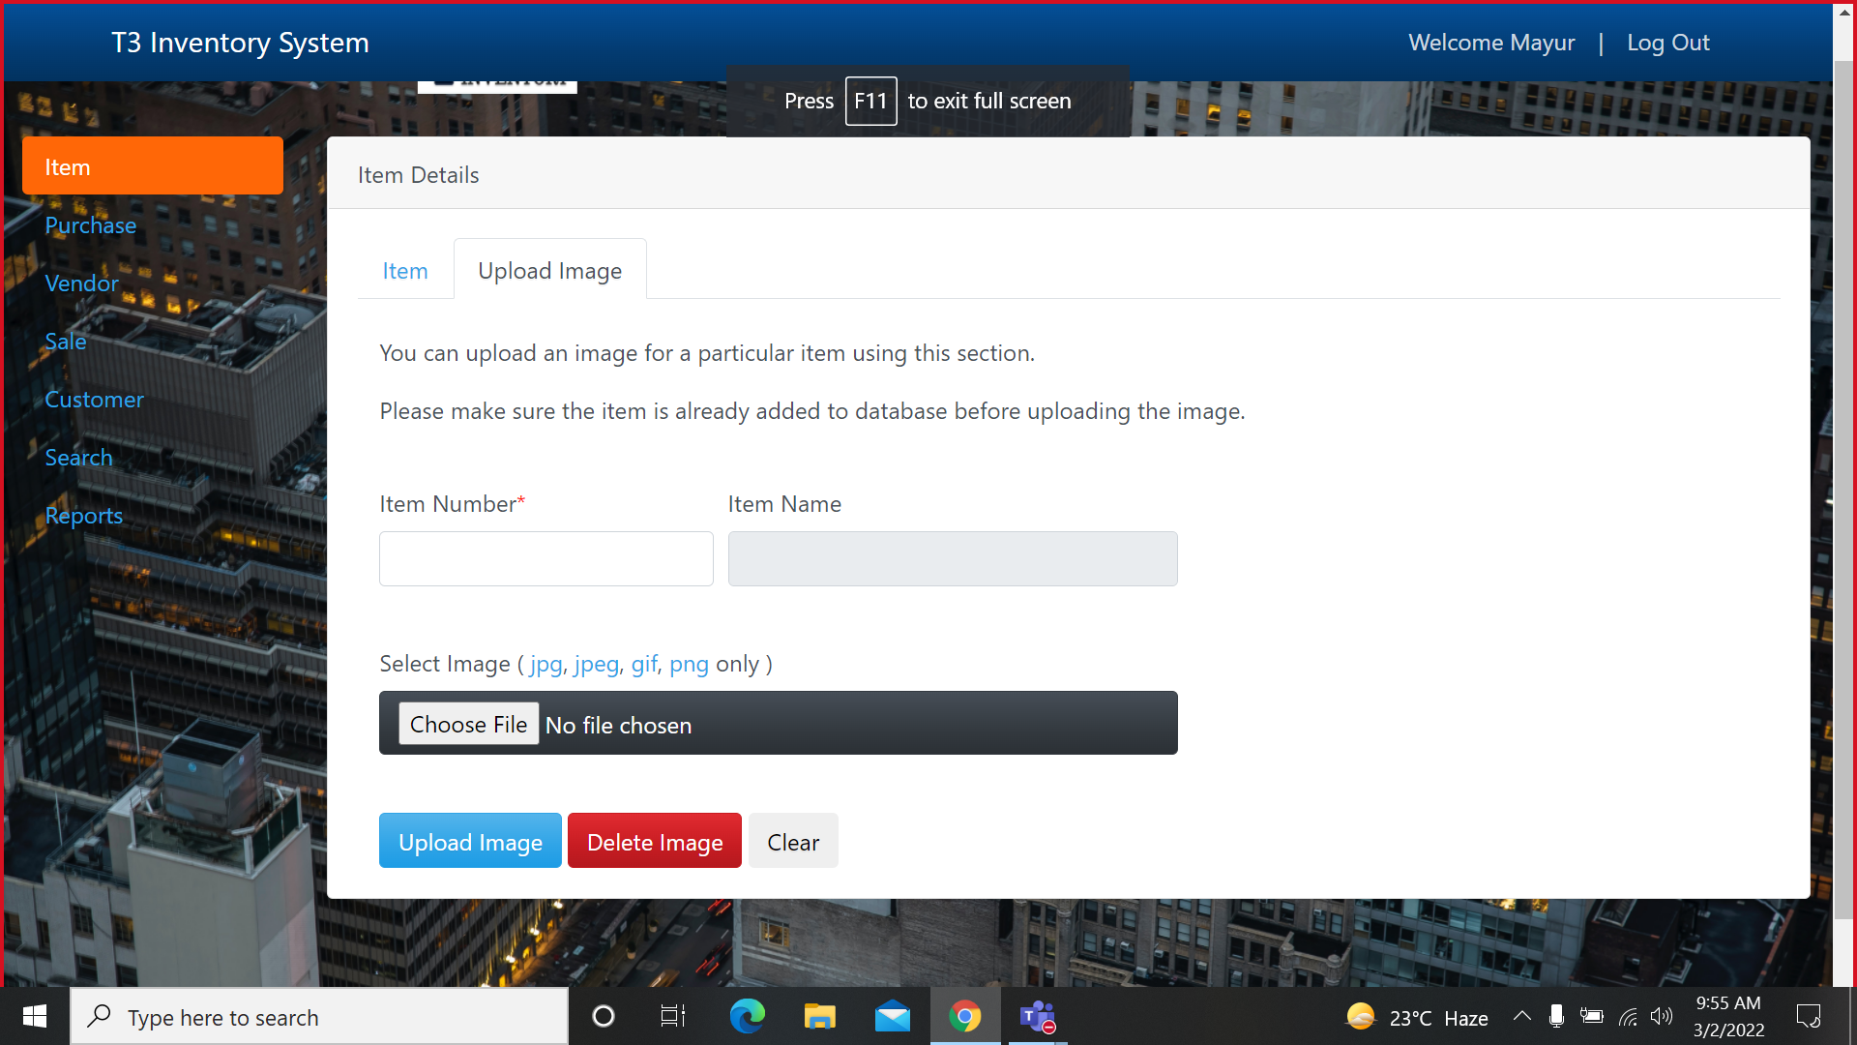
Screenshots

Slide 10
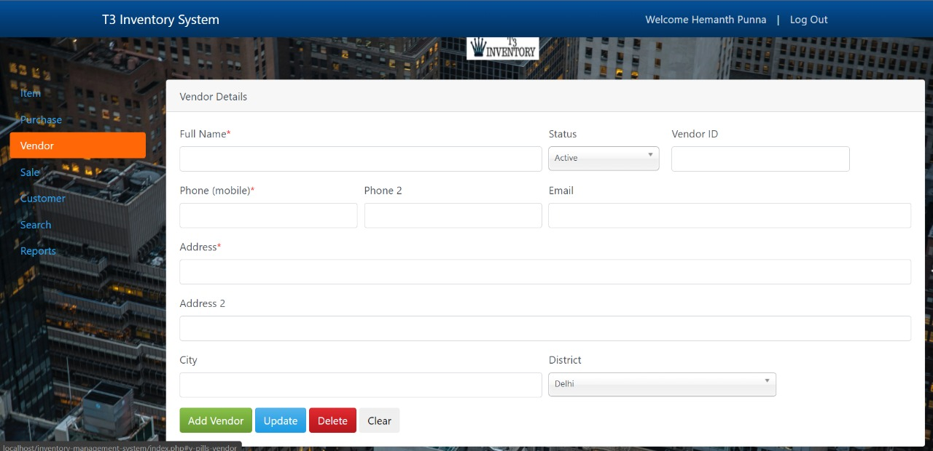
Screenshots

Slide 11
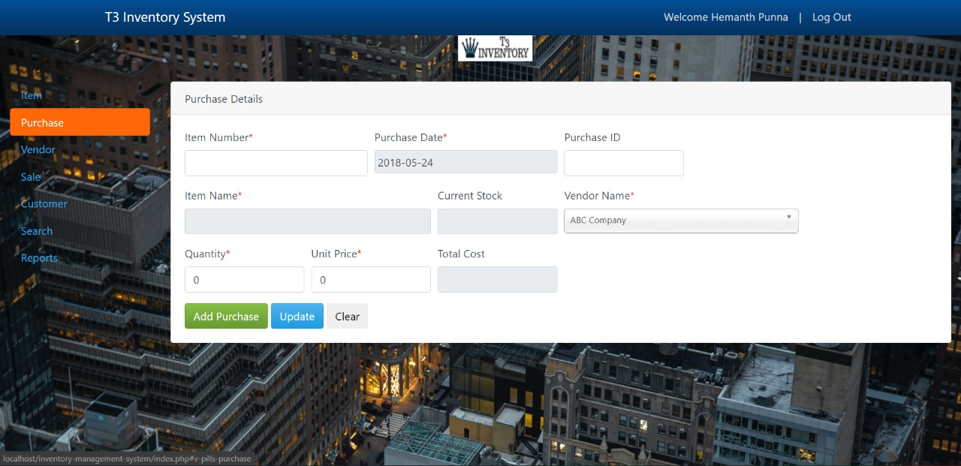
Screenshots

Slide 12
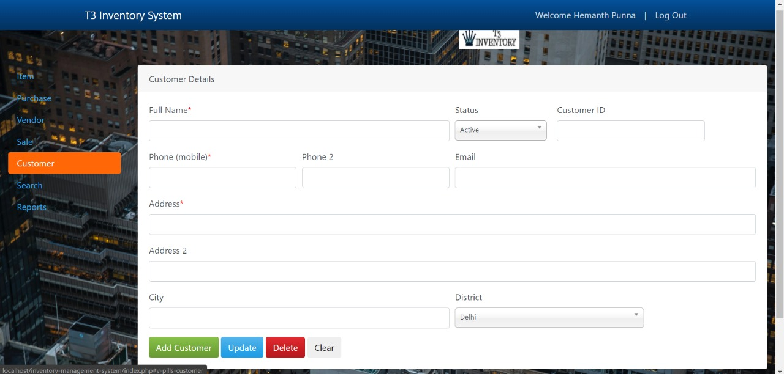
Screenshots

Slide 13
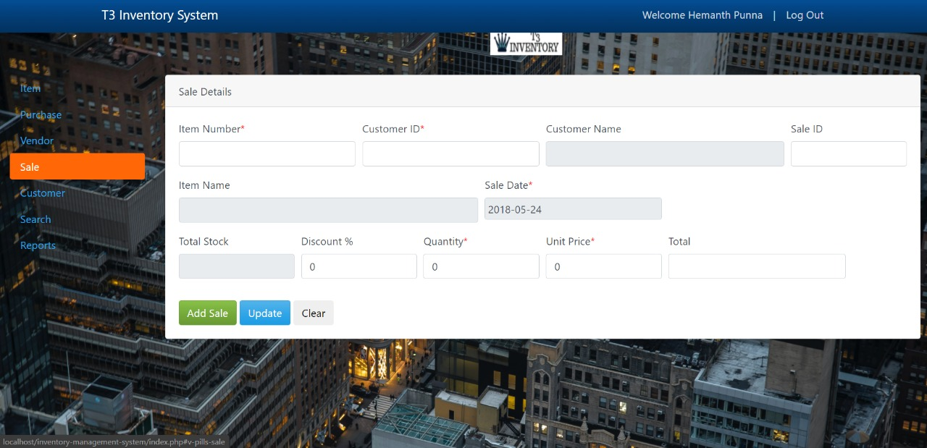
Screenshots

Slide 14
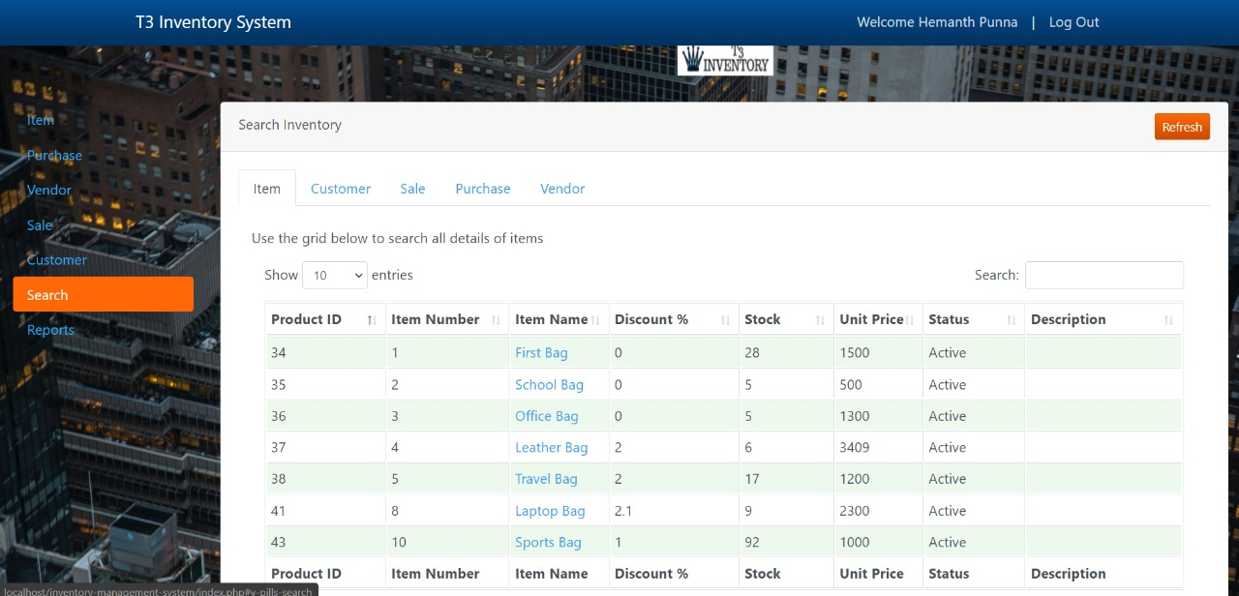
Screenshots

Slide 15
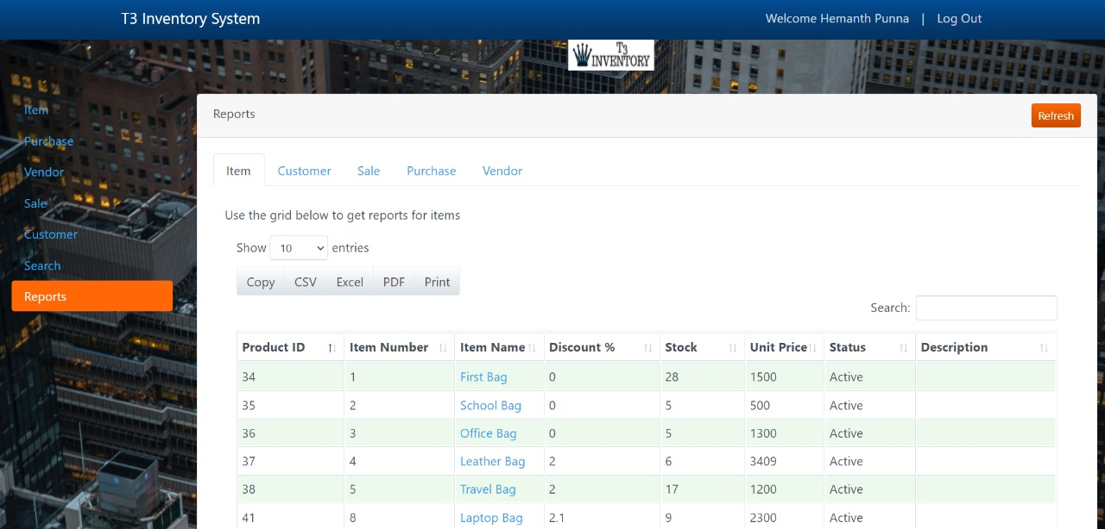
Screenshots

Slide 16
THANK YOU

